Slide 1
Accelerating deep learning on apache spark
Using BigDL with coarse-grained scheduling
Shivaram Venkataraman (Microsoft Research, UC Berkeley)
Ding Ding (Intel)
Sergey Ermolin (Intel) March 2018
www.linkedin.com/in/sergeyermolin

Slide 2
High Performance Deep Learning for Apache Spark* on CPU Infrastructure
Designed and Optimized for Intel® Xeon®
No need to deploy costly accelerators, duplicate data, or suffer through scaling headaches!
BigDL
Spark Core
BigDL is an open-source distributed deep learning library for Apache Spark* that can run directly on top of existing Spark or Apache Hadoop* clusters
Feature Parity &
Model Exchange
with TensorFlow*, Caffe*, Keras, Torch*
Lower TCO and improved ease of use with existing infrastructure
Deep Learning on Big Data Platform, Enabling Efficient Scale-Out
Ideal for DL Models TRAINING and INFERENCE
Powered by Intel® MKL and multi-threaded programming
Notes:
seamless native integration with Spark ecosystem like Spark SQL, Dataframe, MLPipeline, Spark Streaming
BigDL is a distributed deep learning library for Spark that can run directly on top of existing Spark or Apache Hadoop* clusters.
No GPUs needed.
You can write deep learning applications as Scala or Python programs.
You do *not* need to move your data from your cluster elsewhere to perform ML tasks
BigDL provides comprehensive support for deep learning, including numeric computing (via Tensor and high-level neural networks; in addition, you can load pretrained Caffe, TensorFlow or Torch models into the Spark framework, and then use the BigDL library to run inference applications on their data.
Efficient scale out. BigDL can efficiently scale out to perform data analytics at “big data scale” by using Spark as well as efficient implementations of synchronous stochastic gradient descent (SGD) and all-reduce communications in Spark.
Extremely high performance. To achieve high performance, BigDL uses Intel® Math Kernel Library (Intel® MKL) and multithreaded programming in each Spark task. Consequently, it is orders of magnitude faster than out-of-the-box open source Caffe, Torch, or TensorFlow on a single-node Intel® Xeon® processor (i.e., comparable with mainstream graphics processing units).
Why Use BigDL?

Slide 3
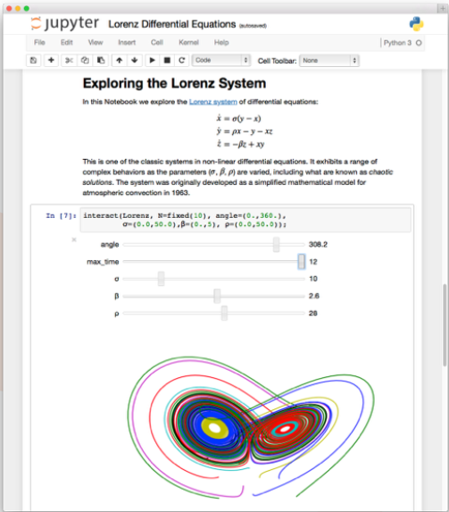
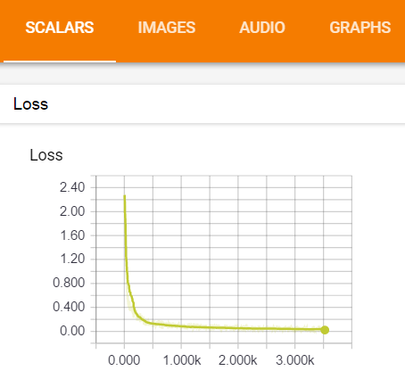
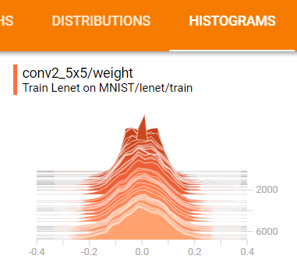
BIGDL
Jupyter, Zeppelin notebooks and TensorBoard support

Slide 4
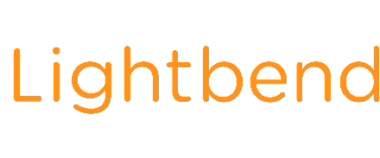
Building & Deploying with BigDL
Platforms
Cloud Service Providers
Solutions
Open Source Community support:
2270+ stars | 500+ forks | 50 contributors
https://bigdl-project.github.io
And Many More…
*Other names and brands may be claimed as the property of others.
Notes:
Intel team worked with MLSListings and Microsoft Azure to build image-similarity based house recommendation solution on BigDL for its customers. A joint technical blog is published for the collaboration.
JD.com applied the Xeon and BigDL based image extraction solution to production for its graph similarity check system, price monitoring system, IP protection system. This usage and result are published at CSDN. In addition, JD.com has listed BigDL as one major deep learning framework in its Moonshot Machine Learning Platform on its public cloud, JCloud.
BigDL is listed on the AWS Market Place AI and Azure Marketplace

Slide 5
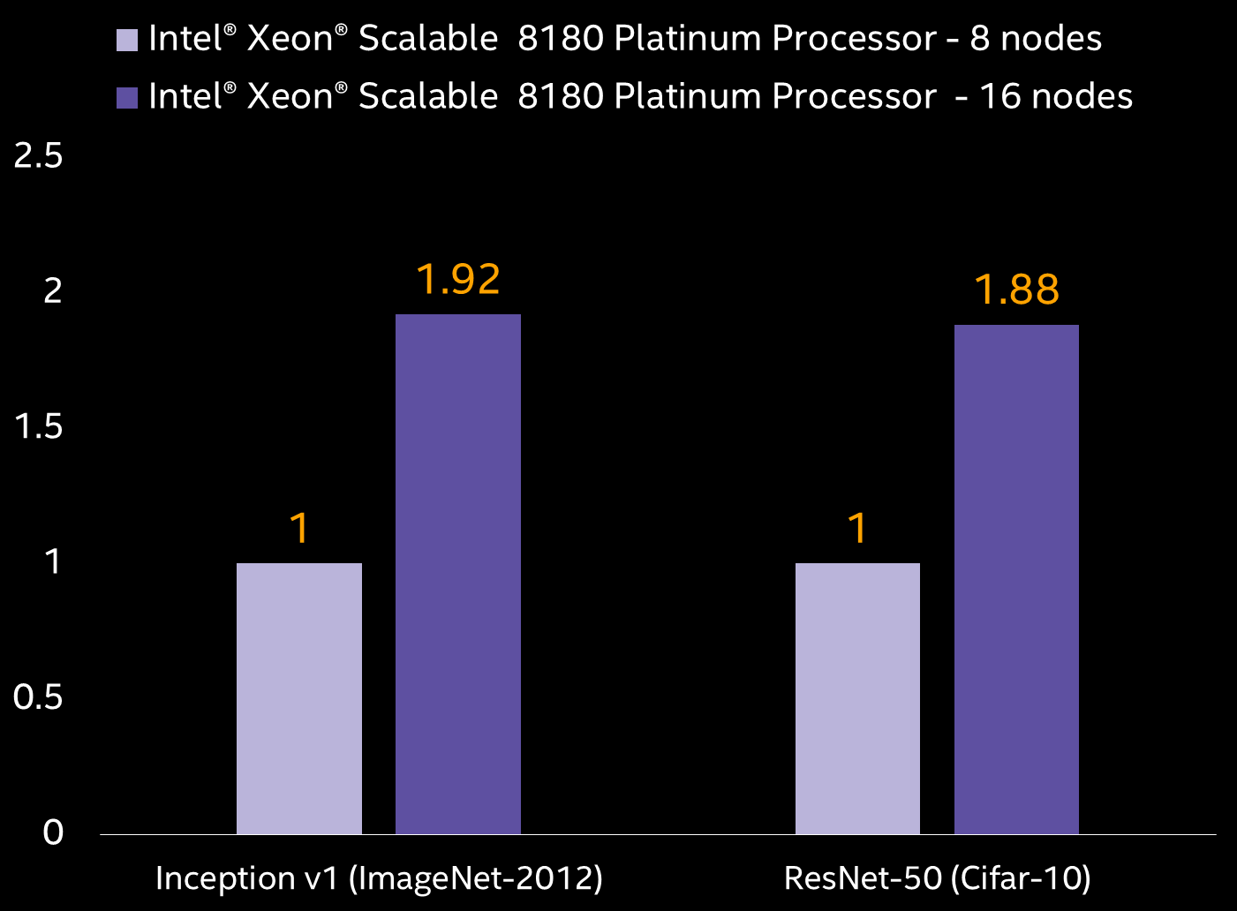
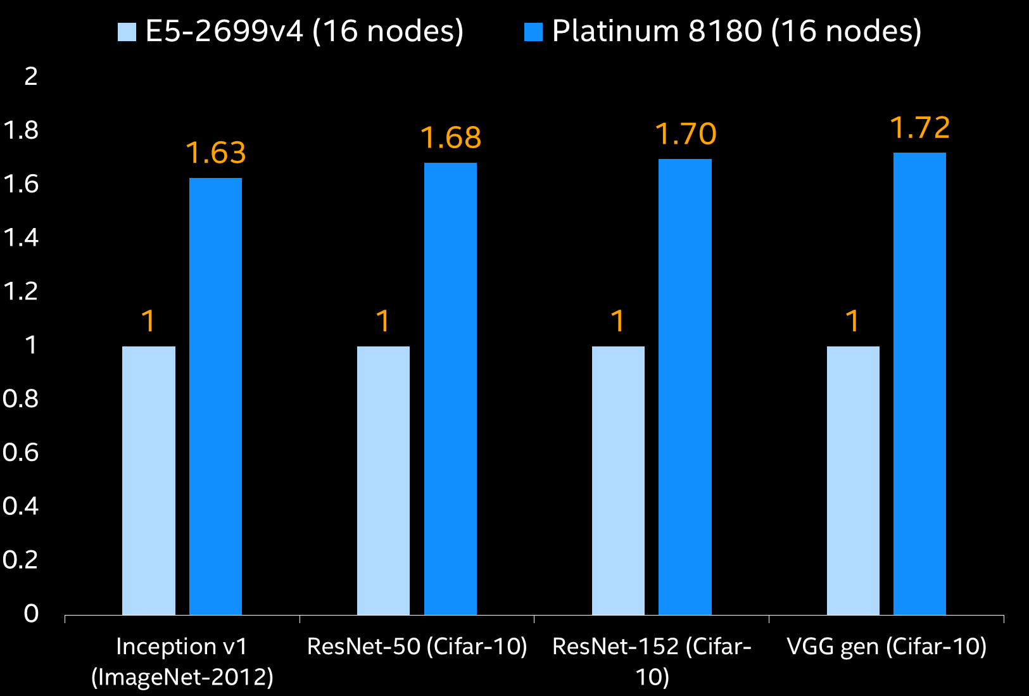
Deep learning with BIGdl/spark
Node Scaling with BigDL
Generational performance increase with BigDL
Get Excellent multi-node scaling and generational performance with your existing hardware
Optimization Notice: Intel's compilers may or may not optimize to the same degree for non-Intel microprocessors for optimizations that are not unique to Intel microprocessors. These optimizations include SSE2, SSE3, and SSSE3 instruction sets and other optimizations. Intel does not guarantee the availability, functionality, or effectiveness of any optimization on microprocessors not manufactured by Intel. Microprocessor-dependent optimizations in this product are intended for use with Intel microprocessors. Certain optimizations not specific to Intel microarchitecture are reserved for Intel microprocessors. Please refer to the applicable product User and Reference Guides for more information regarding the specific instruction sets covered by this notice. Benchmark results were obtained prior to implementation of recent software patches and firmware updates intended to address exploits referred to as "Spectre" and "Meltdown". Implementation of these updates may make these results inapplicable to your device or system. Software and workloads used in performance tests may have been optimized for performance only on Intel microprocessors. Performance tests, such as SYSmark and MobileMark, are measured using specific computer systems, components, software, operations and functions. Any change to any of those factors may cause the results to vary. You should consult other information and performance tests to assist you in fully evaluating your contemplated purchases, including the performance of that product when combined with other products. For more complete information visit: http://www.intel.com/performance Source: Intel measured as of August 2017.
Notes:
Excellent scaling Performance up to 92% going from 8 to 16 nodes
Up to 72% performance in throughput using Xeon ® Scalable Processor over previous generation
No extra cost thru reusing existing analytics infrastructure
Reduced complexity and latency for end to end learning pipeline
Xeon 8180 – SkyLake, 28 cores.
E5-2699v6 – Broadwell, 22 cores.

Slide 6
BigDL 2018 - Roadmap
New Features
Enhanced support for DataFrames (“DLFrames”)
Support for Spark-on-Kubernetes
TensorFlow operations support, MultiRNNCell, Gradient Clipping, etc
Support for Deep Reinforcement Learning and GANs
Usability Enhancements
Improved Python 3.6 support and ‘pip install’
Importing Keras models into BigDL
Keras-like API for Scala and Python
“Model Zoo” improvements and additional use-cases
Performance optimization of RNN training and memory consumption
BigDL version 0.5 is coming in March-April

Slide 7
Strata BIGdl-related presentations
Wednesday 11:50am Accelerating Deep Learning on Apache Spark with Coarse-Grained Scheduling
Wednesday 1:50pm. Accelerating Analytics and AI from the edge to the cloud)
Wednesday 5:10pm. Improving User-Merchant Propensity Modeling using NCF and WAD on Spark BigDL at Scale (FinTech customer use-case deep-dive)
Thursday 11:50am. Automatic 3D MRI knee damage classification with 3D CNN using BigDL on Spark (Medical customer use-case deep-dive)
www.linkedin.com/in/sergeyermolin

Slide 8
FoCUS: cutting SPARK scheduling and comms overhead
Optimizing parameter synchronization and aggregation (PM)
Optimizing task scheduling (Drizzle)
DL tasks are uniquely suited for Spark performance optimization:
Heavy master node workload during model update
Repetitive in nature (reusable task scheduling decisions)
Static data partitioning and cluster configuration

Slide 9
FoCUS: cutting SPARK scheduling and comms overhead
Optimizing parameter synchronization and aggregation (PM)
Optimizing task scheduling (Drizzle)
DL tasks are uniquely suited for Spark performance optimization:
Heavy master node workload during model update
Repetitive in nature (reusable task scheduling decisions)
Static data partitioning and cluster configuration

Slide 10
Parameter Synchronization is a significant part of Deep learning Spark jobs
All Iterative ML Algorithms exchange model parameters after each iterations
(SGD, ADAM, etc)
Model
Param
Update
Model
Param
Update
Model
Param
Update
The larger your cluster and the more complex your model, the more time you waste on model parameter synchronization (scalability problem)
Notes:
ALl of BigDL jobs are iterative algorithsm with model parameter updates.
Now lets zoom in
SGD refresher in this slide.
While (1)
weights_grad = evaluate_gradient (loss_fun, data, weights)
weights += -step_size*weights_grad # perform parameter updates

Slide 11
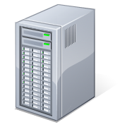
ZOOMING IN: Inside each iteration
Schedule
Tasks
Master node
Training
for (i <- 1 to N) { batch = next_batch() output = model.forward(batch.input) loss = criterion.forward(output, batch.target) error = criterion.backward(output, batch.target) model.backward(input, error) optimMethod.optimize(model.weight, model.gradient) }
A
G
G
R
E
G
A
T
E
Model
Update
…
Compute
Gradient
Notes:
Is this a pseudo-code
We work on a single sample of data from a partition.
Compute gradient works fast on Xeon. Let us speed up the *total* execution by optimizing aggregation and parameter model update.

Slide 12
Baseline: Parameter Synchronization in Spark MLlib
Training Set
Partition 1
Worker
Sample
2
1
Partition 2
3
Worker
Driver
Sample
1
Broadcast model parameters (weights)
to each worker
Each task computes gradients
1
2
2
4
3
…
1
Partition n
Worker
3
Each task sends gradients for (tree) aggregation, and
then driver updates the weight
Sample
2
3
4
Notes:
Data sample comes from a partition. Partition is a Spark DataFrame or RDD.
Simplistic aggregation: four sets of gradients are sent to the driver.
2-stage tree aggregation: tree-like aggregation.
Driver averages out gradients across all sets
Driver broadcasts the updated parameters to all nodes.

Slide 13
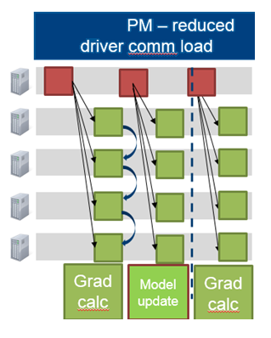
Synchronization via Parameter Manager in BigDL
Distributed
Parameter Manager aggregates gradients and updates model
Master Node is not involved!
All-Reduce synchronization without hotspot and shuffle
Notes:
Hotspots? – bottlenecks created by a centralized driver.
“All-reduce”: r1+r2 is ‘reduce’. All-reduce – broadcasing r1+r2 to everybody
https://rise.cs.berkeley.edu/blog/accelerating-deep-learning-training-with-bigdl-and-drizzle-on-apache-spark/

Slide 14
Synchronization via Parameter Manager in BigDL
PS (Parameter Server) Architecture in BigDL on top of Spark Block Manager
3
5
3
5
3
5
Gradient
Weight
Gradient
Weight
Gradient
Weight
…
4
…
4
…
4
…
…
…
2
2
…
2
Worker
Worker
Worker
1
1
1
…
Partition 1
Partition 2
Partition n
Peer-2-Peer All-Reduce synchronization
Notes:
“All-reduce” what does it mean?
This is a general-purpose abstraction
Block manager by itself does not have peer-to-peer implementation. It needs to be added op top.
Parameter Manager inside BigDL implements a PS architecture (through AllReduce operation) for synchronous mini-batch SGD. After each task computes its gradients, instead of sending gradients back to driver, gradients from all the partitions within a single worker are aggregated locally. Then each node will have one gradient: this ensures that data transferred on each node will not increase if we increase the number of partitions in a node. After that, the aggregated gradient on each node is sliced into chunks and these chunks are exchanged between all the nodes in the cluster. Each node is responsible for a specific chunk, which in essence implements a PS architecture in BigDL for parameter synchronization. Each node retrieves gradients for the slice of the model that this node is responsible for from all the other nodes and aggregates them in multiple threads. After the pair-wise exchange completes, each node has its own portion of aggregated gradients and uses this to update its own portion of weights. Then the exchange happens again for synchronizing the updated weights. At the end of this procedure, each node will have a copy of the updated weights.
As the parameters are stored in Spark Block Manager, each task can get the latest weights from it. As all nodes in the cluster play the same role and the driver is not involved in the communication, there is no bottleneck in the system. Besides, as the cluster grows, data size transferred on each node remains the same and thus lowers the time spent in parameter aggregation, enabling BigDL to achieve near-linear scaling. Figure 3 shows that for Inception V1, the throughput of 16 nodes is ~1.92X of 8 nodes, while for ResNet, it is ~1.88X. These results show that BigDL achieves a near linear scale out performance.

Slide 15
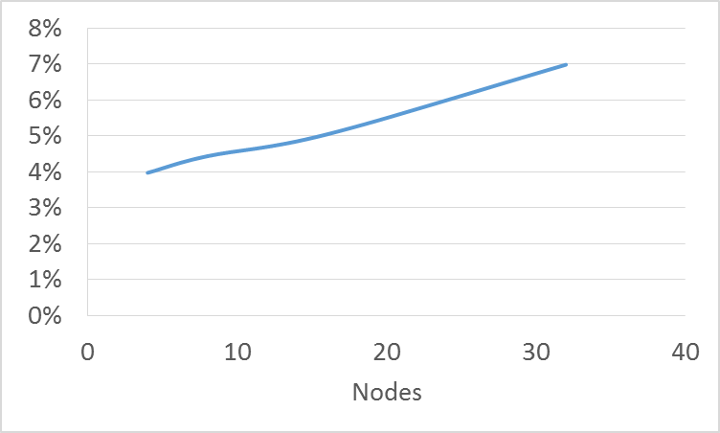
EFFECTS of Parameter Manager implementation in BigDL
Linear scaling
2x node increase – only 1% increase in parameter sync time
Parameter synchronization time as a fraction of average compute time for Inception v1 training
Notes:
Do we have data before PM implementation? Inception
The graph shows the % of time spent on parameter synchronization vs number of nodes.
AR: Sergey to just change “nodes” -> “Tasks” on the slide. (number of tasks=number_of_nodes for this run).
PM is not a panacea and does not benefit all Spark processes. Data wrangling ETL like transformation would benefit from drizzle, but no PM.

Slide 16
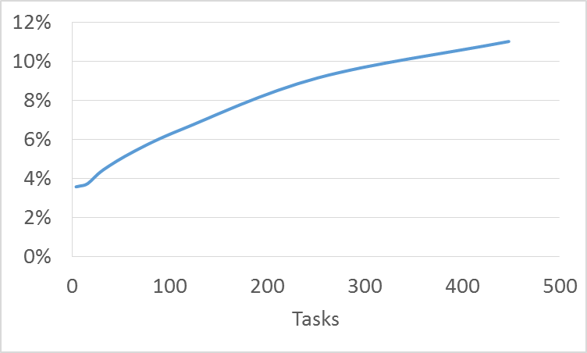
Task Scheduling Overhead
Cores
Total Spark overhead (task scheduling, task serdes, task fetch) as a fraction of average compute time for Inception-v1 training
Notes:
Do we have the graph before Drizzle? Inception
% time spent in scheduling with respect to “tasks”. We assign one task per core, so the scales are similar. MAKE the slides the same. Ding – do you have raw data to plot?

Slide 17
FoCUS: cutting SPARK scheduling and comms overhead
Optimizing parameter synchronization and aggregation (PM)
Optimizing task scheduling (Drizzle)
DL tasks are uniquely suited for Spark performance optimization:
Heavy master node workload during model update
Repetitive in nature (reusable task scheduling decisions)
Static data partitioning and cluster configuration

Slide 18
inside the scheduler
…
…
…
…
…
…
…
…
Scheduler (master node)
?
(1)
Decide how to assign tasks to machines
- data locality
- fair sharing
(2)
Serialize and send tasks
…
…
…
Notes:
Why can’t the scheduler get to super fine granularity?

Slide 19
SCHEDULING OVERHEADS – Scalability problem
Median-task time breakdown
Cluster: 4 core, r3.xlarge machines
Workload: Sum of 10k numbers per-core
Notes:
150 ms for 128 machines out of 205ms more than 70% of time. ** big point is that at 128 machines, cannot run a batch in less than 150 milliseconds. Green bar grows because dataplane shuffle gets worse (we have fixed reducers but more mappers). Don’t need to say green thing but just be prepared for it. ORANGE BARS ARE CONTROL PLANE / coordination.

Slide 20
inside the scheduler
…
…
…
…
…
…
…
…
?
?
Scheduler
BigDL tasks are Repetitive:
Reuse scheduling decisions!
(1)
Decide how to assign tasks to machines
data locality
fair sharing
(2)
Serialize and send tasks
…
…
…
Notes:
Reusing scheduling decisions means that we can schedule tasks for multiple micro-batches (or a group) at once and thus amortize the centralized scheduling overheads. To see how this can help, consider a BigDL SGD algorithm. Assuming that the data partitions remain the same, the locality preference for every micro-batch (SGD step) will also be the same. The cluster configuration remains static, thus the worker-2-task mapping would the identical for every microbatch. Thus we can run scheduling algorithm once and reuse its decision for the entire SGD duration

Slide 21
DRIZZLE
…
…
…
…
…
…
…
…
Goal: remove frequent scheduler interaction
(2) Group schedule iterations
…
(1) Pre-schedule reduce tasks
Notes:
There are two kinds of scheduler interactions: one within a batch and one across batches
What’s the meaning of different colors of circles, triangles, squares?
- The circles, triangles, squares are three kinds of data items produced by the map phase (you can also image them as keys k1, k2, k3 say). Now in the reduce phase all the circles are processed by same reducer and all squares by another one etc. Colors don’t have any specific meaning
Parameter server eliminates the need for the pre-scheduling, but drizzle is a more general-purpose framework that can improve communications overhead even if PM not used.
Data wrangling ETL like transformation would benefit from drizzle, but no PM.
We supply the information where the reduced data needs to go upon the completion of ‘reduce” operation. Once a node completes its compute task, it sends a token to the data destination node which then fetches the data. In a traditional spark execution, driver would collect the metadata (mapping between data partition and the destination) and broadcast it to all nodes.

Slide 22
…
…
Goal: Remove scheduler involvement for reduce tasks
…
(1) Pre-schedule reduce tasks
Notes:
2 classes of arrows going on. just set expectations.
Add to soundtrack here. Could talk about group scheduling first. Shuffle comes out of nowhere.

Slide 23
…
…
?
Goal: Remove scheduler involvement for reduce tasks
…
(1) Pre-schedule reduce tasks
Notes:
2 classes of arrows going on. just set expectations.
Add to soundtrack here. Could talk about group scheduling first. Shuffle comes out of nowhere.

Slide 24
coordinating shuffles: Existing systems
…
…
Data fetched from remote machines
Metadata describes shuffle data location
…
Notes:
In existing BSP systems like Spark or Hadoop, upstream tasks typically write their output to local disk and notify the centralized driver of the allocation of output records to the different reducers. The driver then applies task placement techniques to minimize network overheads and creates downstream tasks that pull data from the upstream tasks. Thus in this case the metadata is communicated through the centralized driver and then following a barrier, the data transfer happens using a pull based mechanism.

Slide 25
coordinating shuffles: Pre-scheduling
…
…
(1) Pre-schedule reducers
(2) Mappers get metadata
(3) Mappers trigger reducers
…
Notes:
Main thing that matters is we trigger once dependencies are met. To remove this barrier, we pre-schedule downstream tasks before the upstream tasks in Drizzle. We perform scheduling so downstream tasks are launched first; upstream tasks are then scheduled with metadata that tells them which machines running the downstream tasks need to be notified on completion. Thus, data is directly transferred between workers without any centralized coordination. This approach has two benefits. First, it scales better with the number of workers as it avoids centralized metadata management. Second, it removes the barrier, where succeeding stages are launched only when all the tasks in the preceding stage complete.
We implement pre-scheduling by adding a local scheduler on each worker machine that manages pre-scheduled tasks. When an upstream task finishes, it materializes the output on local disk, notifies the corresponding downstream workers and asynchronously notifies the centralized scheduler. The local scheduler at the downstream task then updates the list of outstanding dependencies. When all the data dependencies for an inactive task have been met, the local scheduler makes the task active and runs it

Slide 26
DRIZZLE
…
…
…
…
…
…
…
…
Goal: wait to return to scheduler
(2) Group schedule iterations
…
(1) Pre-schedule reduce tasks
Notes:
Avoiding synch across iterations.
To do it, we schedule two iterations at the same time. The control would only come back to the centralized driver after the 2nd iteration.
Iteration time is dictated by the sample size. Smaller iterations are better for convergence.

Slide 27
Group scheduling
Group of 2
Group of 2
Schedule group of iterations at once
…
…
…
…
…
…
…
…
Fault tolerance, scheduling, adding/removing nodes at group boundaries
…
Notes:
This slides shows a Group of 2 iterations. Each iteration here is a map + reduce, so group of 2 "map+reduce" in this case
Q. Why not make the size of the group as large as possible? A. If group size is too large then fault tolerance will be affected and also the ability of scheduler to react to say adding more machines will be affected
There is a provision in Drizzle to adaptively change the size of the group to optimize performance. We use counters to track time spent in various parts of the system. The ratio of time spent in scheduling to the overall execution gives us the scheduling overhead and we aim to maintain this overhead within user specified lower and upper bounds. When the overhead goes above the upper bound, we multiplicatively increase the group size to ensure that the overhead decreases rapidly. Once the overhead goes below the lower bound, we additively decrease the group size to improve adaptivity and error recovery.

Slide 28
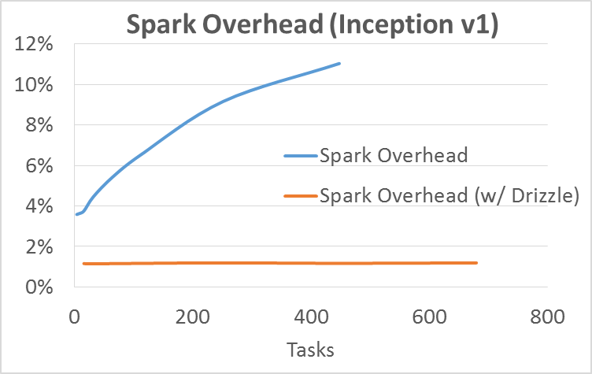
Reducing Scheduling Overheads with Drizzle
For more complete information about performance and benchmark results, visit www.intel.com/benchmarks.

Slide 29
Drizzle – BigDL Performance Improvement Your Mileage will vary…
Group Size
Group Size
Group Size
15% improvement
24% improvement
10% improvement
Notes:
Q: why do the benefits of larger drizzle size diminish as the size grows larger?
A: The improvement goes down because after a certain group size there is very little scheduling overhead remaining. So doing more amortization doesn't help much.
Shivaram, what is the unit measure of “Drizzle size” here? It is “Group size”

Slide 30
cONCLUSION
Deep Learning Spark jobs are somewhat unique
Heavy master node load for large model parameter update
Relatively short execution tasks (for fast model conversion)
Scheduling/Comms sometimes takes ~50% of total task execution.
Deep Learning tasks are uniquely suited for optimization
* Distributed Parameter Manager to offload Master compute.
* Drizzle takes advantage of repetitive nature of the tasks and static data partitioning.
* Need Spark committers community involvement
Notes:
Parameter server eliminates the need for the pre-scheduling, but Drizzle is a more general-purpose framework that can improve communications overhead even if PM not used.
Data wrangling ETL like transformation would benefit from drizzle, but no PM.

Slide 31
Further Reading ☺
https://github.com/intel-analytics/BigDL/tree/new_parametermanager_drizzle
https://github.com/amplab/drizzle-spark
http://shivaram.org/publications/drizzle-sosp17.pdf
Spark Summit 2018: a deeper technical discussion on these topics
www.linkedin.com/in/sergeyermolin

Slide 33
Legal Notices & disclaimers
This document contains information on products, services and/or processes in development. All information provided here is subject to change without notice. Contact your Intel representative to obtain the latest forecast, schedule, specifications and roadmaps.
Intel technologies’ features and benefits depend on system configuration and may require enabled hardware, software or service activation. Learn more at intel.com, or from the OEM or retailer. No computer system can be absolutely secure.
Tests document performance of components on a particular test, in specific systems. Differences in hardware, software, or configuration will affect actual performance. Consult other sources of information to evaluate performance as you consider your purchase. For more complete information about performance and benchmark results, visit http://www.intel.com/performance.
Cost reduction scenarios described are intended as examples of how a given Intel-based product, in the specified circumstances and configurations, may affect future costs and provide cost savings. Circumstances will vary. Intel does not guarantee any costs or cost reduction.
Statements in this document that refer to Intel’s plans and expectations for the quarter, the year, and the future, are forward-looking statements that involve a number of risks and uncertainties. A detailed discussion of the factors that could affect Intel’s results and plans is included in Intel’s SEC filings, including the annual report on Form 10-K.
The products described may contain design defects or errors known as errata which may cause the product to deviate from published specifications. Current characterized errata are available on request.
No license (express or implied, by estoppel or otherwise) to any intellectual property rights is granted by this document.
Intel does not control or audit third-party benchmark data or the web sites referenced in this document. You should visit the referenced web site and confirm whether referenced data are accurate.
Intel, the Intel logo, Pentium, Celeron, Atom, Core, Xeon and others are trademarks of Intel Corporation in the U.S. and/or other countries. *Other names and brands may be claimed as the property of others.
© 2016 Intel Corporation.

